Slide 1
Cattle Management Cattle track Class -----------------------------------Mammals Order----------------------------------Ungulates Family----------------------------------Bovidae Genus----------------------------------Bos

Slide 2
This genus includes all type of cattle ,they are (3) types
1-Bos Taurus------include all European cattle
2-Bos indicus-----include all Indian &Asian cattle.
3-Bos Africans-----include all African cattle.

Slide 3
Cattle are ruminants and have fixed hollow horns not branched and female have udder consisting of (4)part and each part consist teat ,the male stated on the scrotum (4)nipples teats &the cattle used in :-
1-Milk production .
2-Used in agriculture working .
3-Meat production

Slide 4
Udder of cow(4 teat)

Slide 5
Udder of cow(4 teat)

Slide 6
Nipples teat on scrotum of ox

Slide 7
Milking cow

Slide 8
Working cow

Slide 9
Beef cattle

Slide 10
Cattle are divided according to geographical origin into :-
1-Europeanor cattle or cattle of cold temperate region .
2-Indian&African cattle .

Slide 11
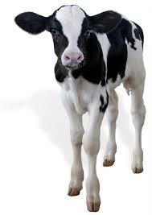
Scientific term :-
Calf :-male or female from birth to the weaning

Slide 12
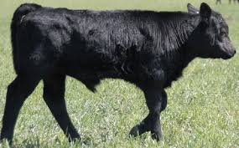
Bull calf :-male from birth until one year old .

Slide 13
Bull calf :-male from birth until one year old .

Slide 14
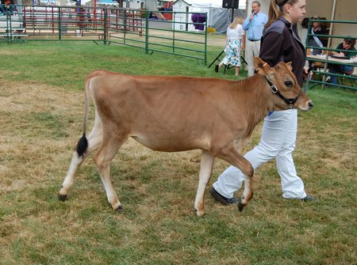
Heifer calf :-female from birth until one year old .

Slide 15
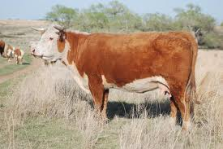
Heifer:-mature female ,old over one year &no pregnant

Slide 16
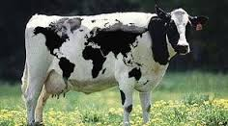
Cow :-mature female used in pregnant &production.

Slide 17
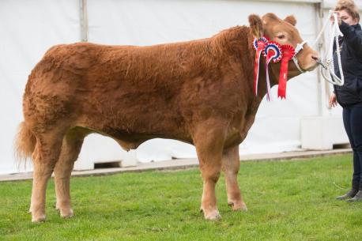
Stear-Bullock :-castrated bull over two years .

Slide 18
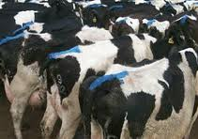
Buller :- cow in estrus cycle .

Slide 20
Dairy Herd Management
Animal milk is economic unit ,feed on material unfit for human consumption and producer food necessary for human consumption with nutritional values &high economic (milk and meat ) .
Dairy cattle is of high importance for the following reasons :-
1-High capacity to absorption of a large amounts of fodder crops and other crop residues .
2-The balance between plant and animal farming in term of the role of mutual between the earth &the animal .
3-Estimated manufacturing to high food intake .

Slide 21
Qualities of dairy cattle
It is divided into :-
A-Formal qualities
1-Udder large &well-formed extended forward and the alliance more than extending it to the bottom .
2-The emergence of vein milk and quality composition .
3-Elongation of the body and the large size of the abdomen &the appearance of bone pinworms .
4-Slender neck & head with harmony .
5-Triangular shape and guided to the body caused by the presence of narrow shoulder &the perimeter was ample and deep abdomen and rear quarters .

Slide 22
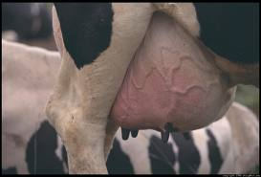

Slide 23
Milk vein

Slide 26
B-Productivity qualities
More important than the formal qualities include.
1-Milk production .
2-Fat%
3-Age at birth .
4-The length of the milking period and drought .
5-Calm when milking .

Slide 27
Dairy cattle Breeds
1-Holstein-Friesian
His Native to the northern parts of the eastern Netherlands *
The average weight at birth (35-45)kg . *
*The average weight of female (600-700)kg and the bull(750-1000)kg .
*The most common color is black &white ,while the color red and White less . * The average of milk production (5000)kg at 305 days .
*The Fat is (3-5.8% ) .
*The color of milk whiter than other breeds due to high efficiency in converting the yellow carotene into vitamin A .

Slide 28
Holstein-Friesian

Slide 29
Holstein-Friesian

Slide 30
2-The Jersey
* His native in jersey island of British .
The average weight at birth (25)kg.*
*The average weight of female (400)kg and the bull(400-600)kg .
*The most common color is Brown yellow dun and found white spot. * The average of milk production( 2500)kg at 305 days . *The Fat is (5.35-5.50 % ) .
*The color of milk tendency to yellow.

Slide 31
Jersey Breed

Slide 32
Jersey Breed

Slide 33
3-The Ayr shire .
* His native in (Ayr) country in southeast of Scotland .
The average weight at birth (40-45) kg *The average weight of female (450)kg and the bull (650)kg .
*The most common color is Red or Brownchocolate with small White spot . . * The average of milk production( 4100)kg at 305 days . *The Fat is (4% )

Slide 34
Ayr shire Breed

Slide 35
Ayr shire Breed

Slide 36
4-The Brown Swiss
* His native in Swiss country .
The average weight at birth (40-45) kg.* *The average weight of female (600)kg and the bull (725)kg .
*The most common color is Dark &pale brown . * The average of milk production( 2570)Lt at 305 days . *The Fat is (4%

Slide 37
Brown Swiss Breed

Slide 38
Brown Swiss Breed

Slide 39
Type of Iraqi cows
1-South cows .
2-Alshrabia cows .
3-Alkurd cows .
4-Alrustakia cows .
5-Crossbreed cows

Slide 40
Dairy Cattle Management
The life of dairy cattle are divided in to (3)phases depending on the circumstances ordinary &each phase need to special requirements
In terms of administration and care, the care of male differ from female &these phases are :-
1-Calf hood management phase .
2-Pre-mature phase .
3-Maturity phase .

Slide 41
Calf hood management phase
This period is begin from the (birth to age at 6 months ).
a-The breathing of newborn begin directly after birth &this physiological phenomenon can be summarized as follows :-
when cut the umbilical cord (no interruptions circulation of the fetus to his mother or vice versa increase the amount of (co2)in the newborn blood ,which stimulate the respiratory center in the brain which to do homework &his reflex caused by exposure suddenly born to the outer atmosphere .

Slide 42
b-Cut the umbilical cord .
After making sure of the safety breathing for the newborn begins to cut the umbilical cord by using sterile scissor & the site of cutting distant from the surface of abdomen about (10)cm , then linking the umbilical by a string sterile and disinfected it by use iodine or antibiotic powder such as sulfa .

Slide 43
Cut the umbilical cord

Slide 44
c-Drying the body
we must be drying the body of newborn after parturition from the allantoises fluid which cover here body by using the clothes or any thing fond in the site due to prevent the cold or respiratory infection .

Slide 45
Drying the body

Slide 46
Drying the body

Slide 47
d-Claws trim .
Yellow horny layer on the belly of claws present, can see it after birth in newborn animal ,we must removed this layer to help the animal to stand. the strong newborn can stand on their legs through (20- 30)mints after birth , while the weak newborn standing after(2)hours & needed to help it .

Slide 48
e-The calves directing to breastfeeding .
The newborns begin to breastfeeding after (2-6)hours of birth .
Type of breastfed
1-Natural breastfed .
2-Artifical breastfed .

Slide 49
The pre-mature phase
This period begin from age (6)months to the first parturition for the animal (2.5-3)years ,this phase include :-
*The maturity age of cattle (first estrus cycle ) at age (8)month old .
*The time of mating at age (1.5-2)years .
*The period between two estrus cycle (21)days ,the estrus cycle appear during the night or in the early morning .
*The estrus cycle extended (9-28) hours .
*The gestation period in cow (9)months or (271)days .

Slide 50
Sign of estrus cycle
1-Restlessness &standing while the other animal quite casting .
2-The cow jumping on other animal if it free .
3-Shaking the tail &rise it up .
4-The animal prevented from eating and decrease in rumination .
5-Descnt of urine as drops and increase the urination .
6-congestion of the mucous membrane lining the vagina with the descent of transparent mucous discharge from the vulva.
7-Regular intervals voices exited from the animal .

Slide 51
Sign of pregnancy in cattle
1-Stop estrus cycle .
2-The animal become good healthy &increase in weight .
3- Refuse the male .
4-increase in the abdominal size gradually &the back curved and Abdominal descent to lower at age (4)month of pregnancy .
5-Decrease in milk production and enlargement the udder at age (8)months of pregnancy .
6-We can diagnosis the pregnancy by (rectal palpation )for all stage of pregnancy .

Slide 52
The Maturity phase
This period began from the first parturition to end age of the animal production ,his phase characterized by pregnancy and childbirth beside the daily milking until drying , the drying of animal doing at(60-90)days before parturition to the animal of high production and (40-60)days to the animal of low production

Slide 53
The Milking
The purpose from milking operation is to get the milk from udder and we can get the milk by these ways
1-Nursing .
2-Hand milking .
3-Machin milking .

Slide 54
How draining pregnant cow
a-Reduce the number daily milking time or leave amount of milk in the udder when milking . b-Reduce the amount of feed temporarily until drying of the animal
c-Drying was done through a week .

Slide 55
Management of the adult Bulls
*Average age production of the bull(1.5-4.5) years . *The bull at age one year can mating (10)cows .
*The bull at age (2) year can mating (20-30)cows
.
*The bull at age (4-5) year can mating (60-80)cows .

Slide 56
Beef cattle
`Animal have a good efficient in food conversion
Meat production is affected by many factors, these are :-
1-Breeds 2-Age 3-Nutrition 4- care
The characterized of Beef cattle
1-The integration of member of the body with each other and short leg .
2-The neck short and thick ,filled with meat especially the body contact area .
3-Coated meat shoulder and back straight ,broad and consist supply4-Large abdomen and wide chest the shoulder filled with muscles .
5-Thigh thick and full with muscles for an extend shank .
6-Solid body with a smooth skin texture and smooth shiny hair .
7- Beef cattle is characterized by fast growth and high efficiency in feed conversion to meat and fat

Slide 57
Cattle temperate and moderate cold
First :-Thoroughbred Beef cattle .
1-The Aberdeen-Angus breed
*His native in British .
* The average weight of male (750)kg and female(650-700)kg.
*The most common color is Dark black &claus,muzzle black .

Slide 58
The Aberdeen-Angus breed

Slide 59
*His native in middle British . * The average weight of male (850)kg and female(700)kg. *The common color is Red while the back ,lower abdomen&
2-Hereford breeds

Slide 60
Shorthorn breeds *His native in eastern British . * The average weight of male (880-950)kg and female(700)kg. *The common color is red& white or mixture(mosaic

Slide 61
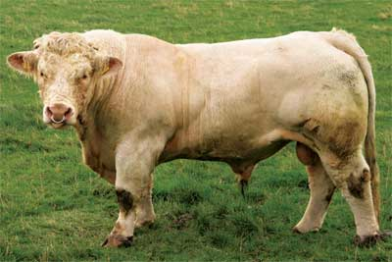
5-Sharolais breeds
*Resides in France .
*Bull weight (1000)kg &cow (750)kg . *The color white (blond)

Slide 62
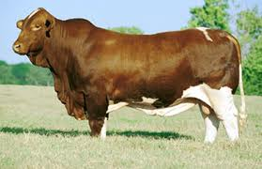
7- Alsanta- Gertrud's breeds.
8-The Beef master breeds

Slide 63
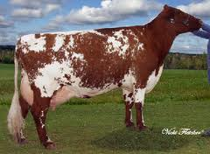
Second :-The Dual –purpose cattle
1-The milking shorthorn breeds
*Bull weight (450)kg &cow (350)kg .
*Milk production (4100) kg in season .

Slide 64
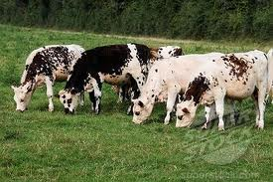
2-Normandy France breed s
*Bull weight (1080)kg &cow (770)kg .
*Milk production reach to (4000)kg /season . *White Maroni body color with white spots .

Slide 65
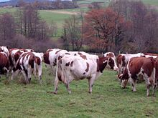
3-The Monbelard France breeds
*Red color body with white spots .
*Bull weight (915)kg &cow (770)kg
*Milk production reach to (4000)kg /season

Slide 66
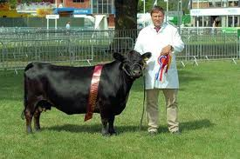
4-The Redpoll breeds
5-The Dexter breeds

Slide 67
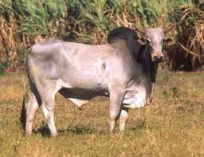
Third:-Asian cattle
1-Braham breeds.
*Containing Hump, the ear wide long &the horn distended up . *The common color is Grey *Dewlap overhangs the bottom of the neck .
*Bull weight (800)kg &cow (550)kg .

Slide 68
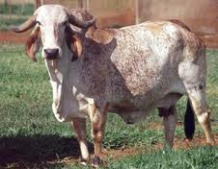
2-The Gir breeds
*His native in India .
*The common color mostly white with spots &red area.
*Low milk production . *Bull use for Job .

Slide 69
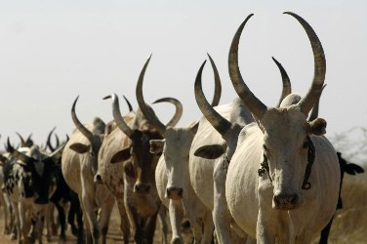
Fourth:- African cattle.
1-Nilotic breeds
*His native in South Sudan .
*Hybrid from African x Indian &Hump present .
*The common color white&grey ,red and black .
*Bull weight (310)kg ,cow(200) kg .
*The meat of this breeds finest meat in Sudan .

Slide 70
2-Dama breeds .
*Located in west Africa ,yellow color or pale yellow
and bull (310) kg .

